Slide 1
Lecture 30
IEEE 1149.4 JTAG
Analog Test Access Port and Standard
Motivation
Bus overview
Hardware faults
Test Bus Interface Circuit (TBIC)
Analog Boundary Module (ABM)
Instructions
Specialized Bus Circuits
Summary

Slide 2
Purpose of Analog JTAG Standard
For a System-on-a-Chip (SOC):
  Cannot assume that we are interconnecting pre-tested modules
  Internal module probing is impractical
  Solution: Use boundary scan structure to partition analog, digital, and memory sub-systems in SOC and test each separately
Analog JTAG test capability:
  Oriented towards measuring external component values or internal impedances (shorts, opens, wrong components)
  Not intended for DSP type analog tests

Slide 3
Analog Test Bus
PROs:
  Usable with digital JTAG boundary scan
  Adds analog testability – both controllability and observability
  Eliminates large area needed for analog test points
CONs:
  May have a 5 % measurement error
  C-switch sampling devices couple all probe points capacitively, even with test bus off – requires more elaborate (larger) switches
  Stringent limit on how far data can move through the bus before it must be digitized to retain accuracy

Slide 4
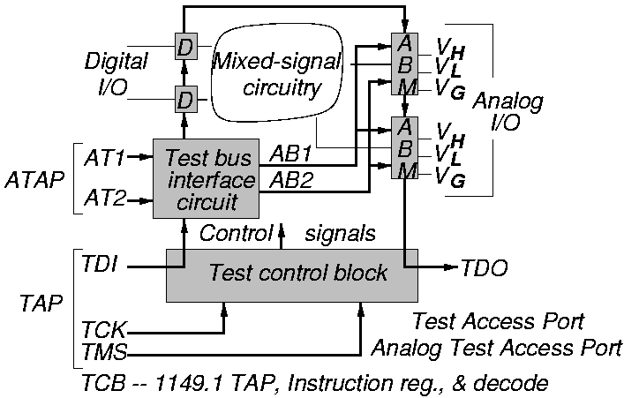
Analog Test Bus Diagram

Slide 5
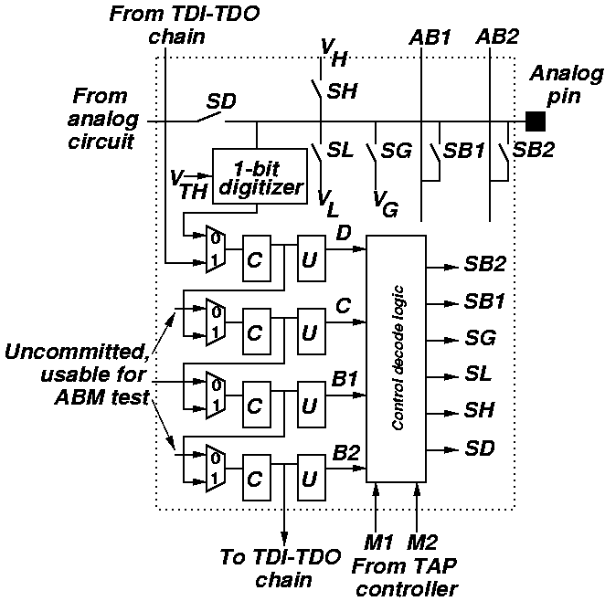
Analog Boundary Module

Slide 6
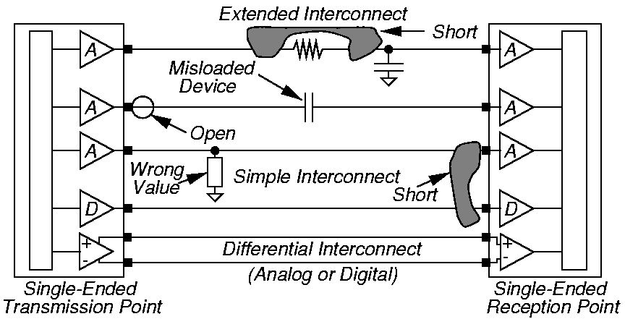
Analog Defects and Faults

Slide 7
Need for Discrete Components
Impedance matching of transmission lines necessary – merchant ICs will not have built-in impedance matching resistances
Discrete resistors use much power – may prevent them from being on-chip
Impossible to make high-valued, accurate inductors or transformers on chip
Integrated R, C, L components are never as precise as external ones
Some ICs can be extended to more functions if external R, C, or L value can be changed

Slide 8
Measurement Limitations with 1149.4
Must test device with power on
Multiplexing done with silicon devices, not relays
Introduces unwanted impedances during testing
Has additional current leakages to ground
CMOS silicon switches non-linear over larger signal swings – may also be slow
1149.4 bus has less than 1 MHz bandwidth

Slide 9
Switch Limitations
Parameter
On-resistance
Off-resistance
Bidirectional ?
Switching time
Area μm²
Relay
10⁻² Ω
10¹² Ω
Yes
500 μs
96.7 x 10⁶
CMOS
10² to 10³ Ω
10¹² Ω
Yes
< 1 μs
20
Bipolar
Varies
10¹⁰ Ω
No
< 1 μs
100 to 5000

Slide 10
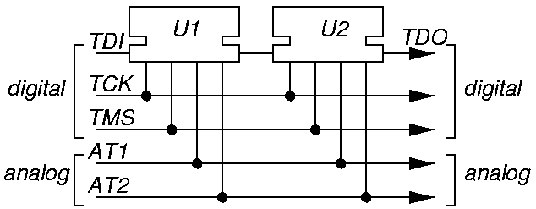
Chaining of 1149.4 ICs

Slide 11
Analog Test Access Port
TDI, TDO, TCK, TMS signals from Digital standard are required
TRST signal from Digital standard is optional
New required analog signals:
  AT1 – for analog stimulus
  AT2 – for sending analog response to ATE
  AT1 and AT2 can be partitioned
Digital part same as before, except:
  New Test Bus Interface Circuit (TBIC)
  Multiple digital pin cells grouped into Digital Boundary Module (DBM)
  Set of cells required to control analog pin grouped into Analog Boundary Module (ABM)

Slide 12
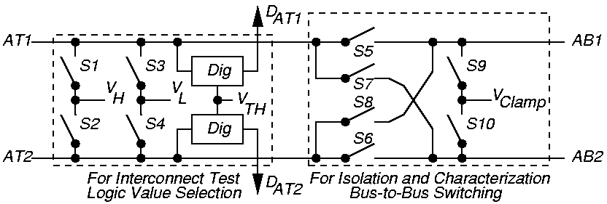
Test Bus Interface Circuit

Slide 13
TBIC Functions
Connect or isolate analog measurement buses AB1 and AB2 within chip to or from external AT1 and AT2 signals
Perform 1149.1 interconnect tests on AT1 and AT2 pins
  Support coarse digitization relative to threshold V_{TH}
Support analog characterization measurements
  Clamp busses not being driven

Slide 14
TBIC Switching Patterns
P
#
0
1
2
3
4
5
6
7
8
9
Function
ATn disconnect (high Z), clamp ABn
Connect AT2 & AB2 P1 – P3
Connect AT1 & AB1 for analog
Connect ATn & ABn measurement
AT1 / 2 drive 00 out P0 & P4 --
AT1 / 2 drive 01 out P7 for 1149.1
AT1 / 2 drive 10 out interconnect
AT1 / 2 drive 11 out test
For characterization
For characterization
Switch
state
S1-S10
for
patterns
given
in
book

Slide 15
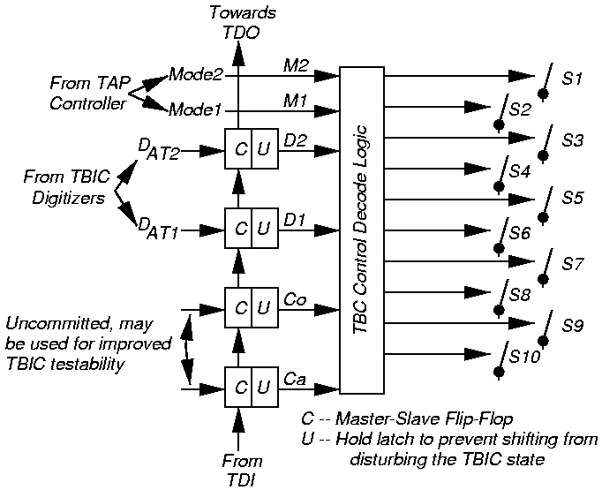
TBIC Switch Controls

Slide 16
Analog Boundary Module Has Four Control Cells
Work in conjunction with TBIC and various 1149.4 bus modes to set state for one analog pin:
  Calibrate (Ca)
  Control (Co)
  Data1 (D1)
  Data2 (D2)
Test mode determined by 4 ABM digital pins and by TBIC switches S1-S10

Slide 17
ABM Switch Patterns
Pattern #
0
1
2
3
4
5
6
7
8
9
10
11
12
13
14
15
16
17
18
19
Pin State
Completely isolated
Monitored (mon.) by AB2
Connected (conn.) to AB1
Conn. to AB1, mon. by AB2
Connected to VG
Conn. to VG, mon. by AB2
Conn. to VG & AB1
Conn. to VTG & AB1, mon. by AB2
Conn. to VL
Conn. to VL, mon. by AB2
Conn. to VL & AB1
Conn. to VL & AB1, mon. by AB2
Conn. to VH
Conn. to VH, mon. by AB2
Conn. to VH & AB1
Conn. to VH & AB1, mon. by AB2
Conn. to core, isolated from test
Conn. to core, mon. by AB2
Conn. to core & AB1
Conn. to core & AB1, mon. by AB2
SD, SH,
SL,SG,
SB1, SB2
Switch
states
for the
pattern
given in
book

Slide 18
TBIC Patterns & ABM Values
4 Cells
0000
0001
0010
0011
0100
0101
0110
0111
1000
1001
1010
1011
1100
1101
1110
1111
EXTEST
CLAMP
RUNBIST
P0
P1
P2
P3
P4
P5
P6
P7
P0
P8
P9
*
*
*
*
*
PROBE
INTEST
P0
P1
P2
P3
*
*
*
*
*
*
*
*
*
*
*
*
HIGHZ
P0
P0
P0
P0
P0
P0
P0
P0
P0
P0
P0
P0
P0
P0
P0
P0
BYPASS, SAMPLE
PRELOAD, IDCODE
USERCODE
P0
P0
P0
P0
P0
P0
P0
P0
P0
P0
P0
P0
P0
P0
P0
P0

Slide 19
Analog Boundary Module Functions
One-bit digitizer captures pin voltage and interprets it as digital
Simultaneously provides one more more of these functions at an analog pin:
  Connect pin to V_{L}
  Connect pin to V_{H}
  Connect pin to V_{G} (reference quality)
  Connect pin to AB1 (provides current)
  Connect pin to AB2 (monitors voltage)

Slide 20
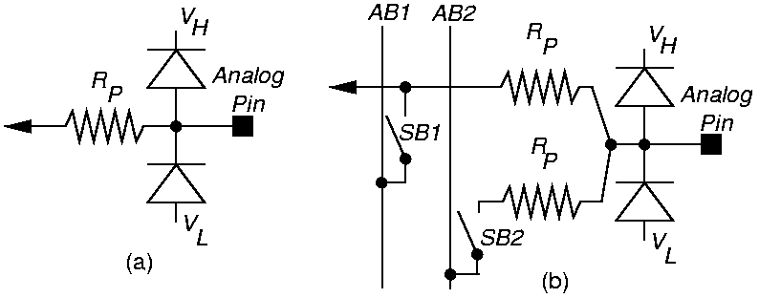
Electro-Static Discharge Protection for ABM
(a) Ordinary pin (b) ABM pin

Slide 21
EXTEST Instruction
Can disable or enable each of these connections for each analog pin:
  Core-disconnect state (disconnected from internal analog circuitry)
  Connect to V_{L}
  Connect to V_{H}
Had to be individually pin programmable, because bias voltage pins can never be disconnected, and low impedance R’s or L’s often cannot be disconnected
Core-disconnect state often not implemented with a transistor, since that can reduce driver performance

Slide 22
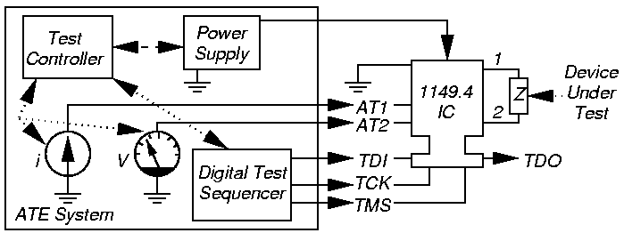
ATE External Impedance Measurement with EXTEST

Slide 23
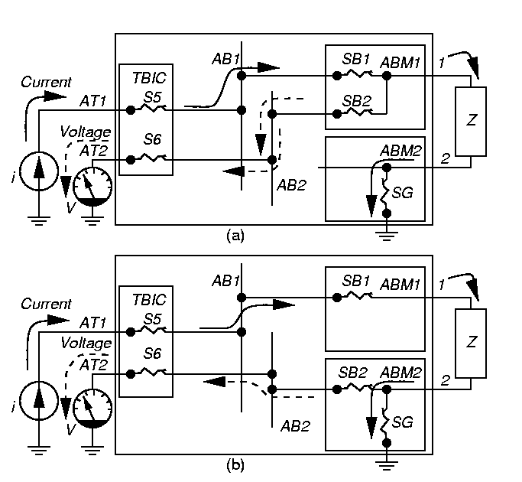
1149.4 Measurement of External Impedance
(a) Pin 1 voltage measurement

Slide 24
Pin 2 Voltage Measurement
  V_{Pin1} – V_{Pin2}
  I
Z =

Slide 25
CLAMP and HIGHZ Instructions
CLAMP – Disconnects all pins from cores and freezes analog pins in present state
  Freezes TBIC in present state
  Keeps circuit quiescent, while V and I are measured in other parts
HIGHZ – Opens core disconnect switch SB
  Disconnects all test circuits
  Disables TBIC

Slide 26
New PROBE Instruction
Required
Works similarly to digital SAMPLE instruction
Operates on both digital and analog pins
Allows continuous time sampling while analog core is functioning
  Can only sample 1 analog pin at a time (only 1 set of ABn wires exists)
  Sets all Analog and Digital Boundary Modules to connect all pins to cores
AB switch may add parasitic element into circuit
Most useful for noise measurements
Can make f measurements only up to 1 kHz

Slide 27
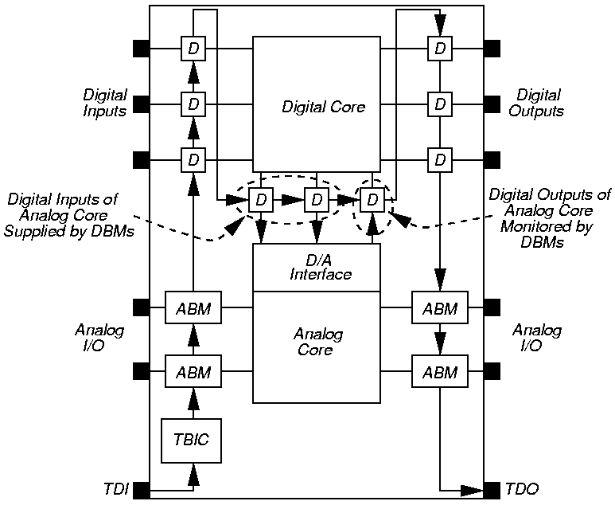
INTEST Instruction
At any
time, only
1 analog
pin can
be stimu-
lated
and only
1 analog
pin can
be read

Slide 28
RUNBIST and SAMPLE / PRELOAD Instructions
RUNBIST – operates exactly as in 1149.1 digital standard
  Analog pins can either mimic HIGHZ or CLAMP instructions
SAMPLE / PRELOAD – for Analog pins
  Digitizes the analog pin voltage
    Stored as ‘1’ if > V_{TH}, otherwise as ‘0’
    Stored in boundary register

Slide 29
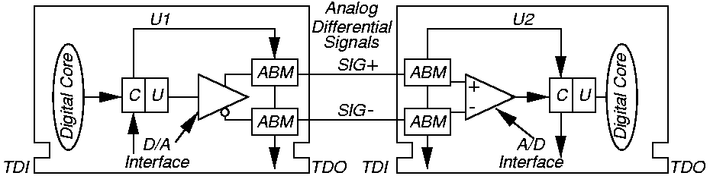
Differential Interconnect
Greatly improves common-mode noise rejection
  Can still work, even when single lines or R’s are opened or shorted

Slide 30
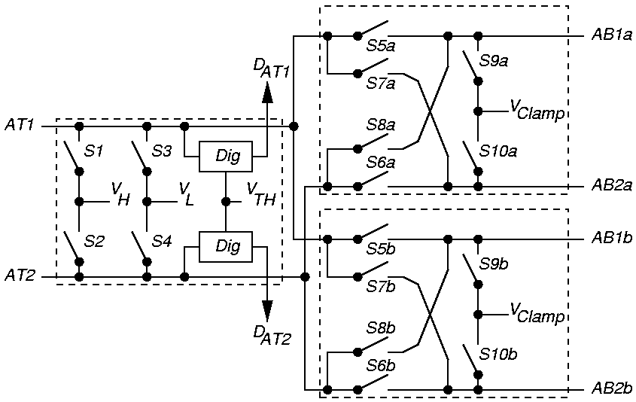
Partitioned AB Busses

Slide 31
Isolation of Analog and Digital Cores
1149.4 standard requires that a digital boundary module be on each digital line between digital and analog core
  Only when INTEST or RUNBIST instructions supported, otherwise can eliminate DBM
Can use analog boundary module to test digital pins & interconnect with 1149.4

Slide 32
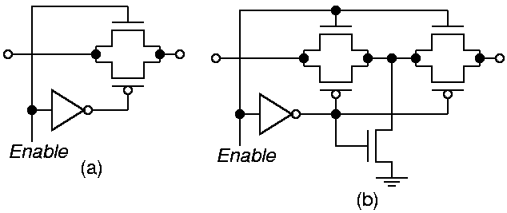
Analog Switch to Reduce Coupling

Slide 33
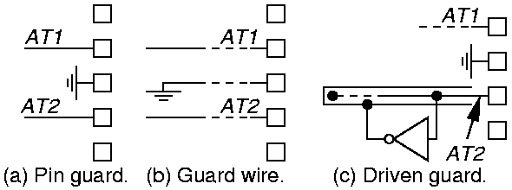
Guarding Between Signals

Slide 34
Summary
Analog test bus allows static analog tests
Non-static or feedback circuits are hard to test
Good for locating shorts, opens, and wrong external component values
  V_{H} and V_{L} switches in ABM must be able to survive large voltage differences
Needs customizing digitizing receiver for digitizing analog bus – inverter not suitable
Can eliminate separate process monitor transistors and resistors on wafers – saves area
Needs large, low-resistance transistor switches to avoid common mode measurement errors

